Slide 1
CUES to USE
Network Science – Spring 2022
Team Members:
Raghav Chegu Shyam Kumar
Shefali Mahendra Luley
Tanay Sainath Kulkarni

Slide 2
Introduction
Words are one of the most fundamental components of today’s world, and it's fascinating to watch how some words are recalled when given a specific term.
People are more likely to recall a word that has a memory associated with it, or even a term that is related to its meaning.
In this study, we will aim to figure out how people recall words based on cues from other words, as well as look for patterns in how people memorize and connect words.

Slide 3

Motivation
To learn why people remember specific words when given a cue word in a specific context.

Slide 4
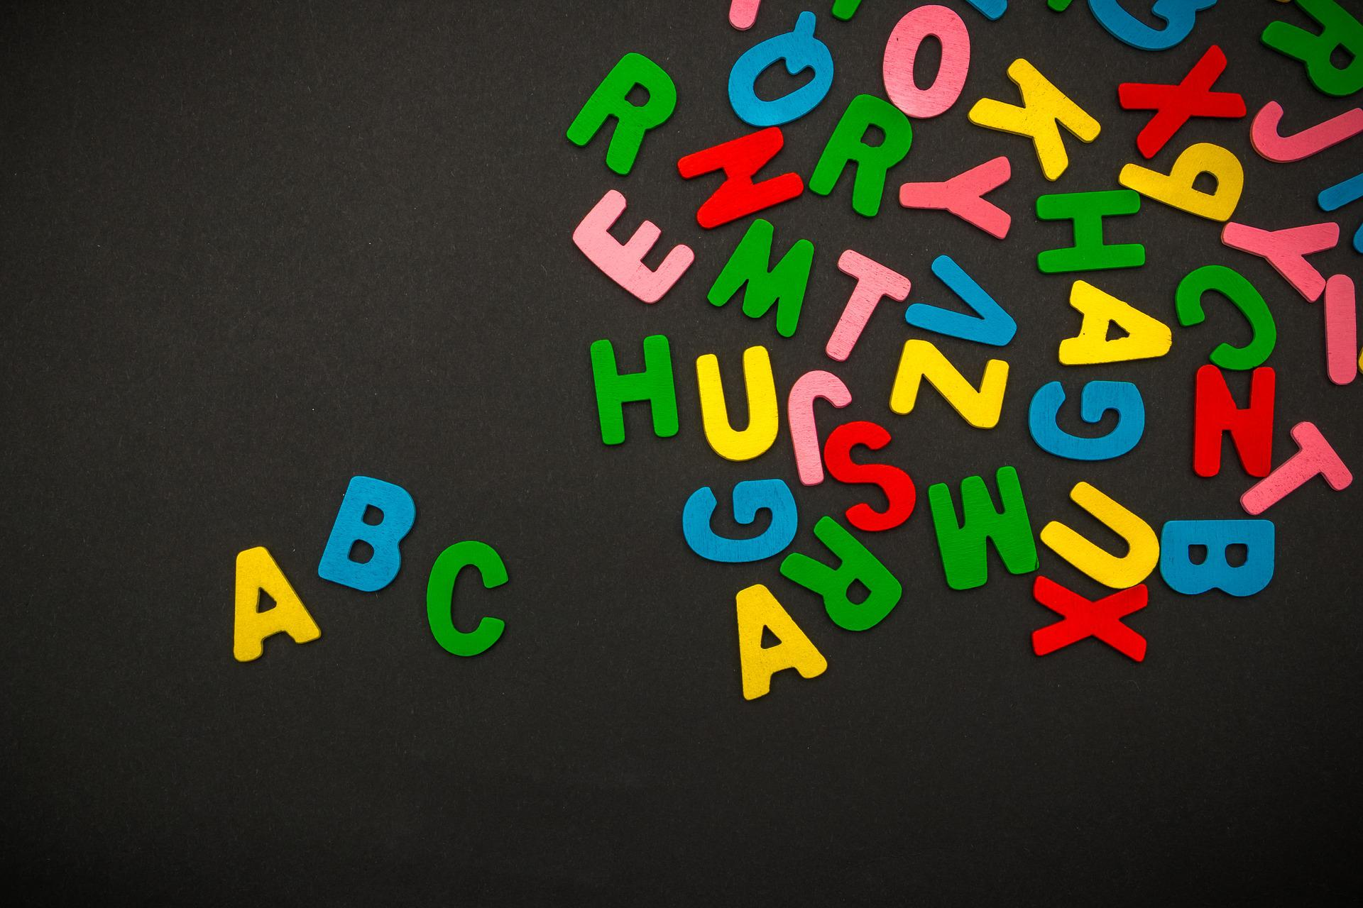
What are we tackling?
Can we analyze features of words that recall certain words, and can we know what qualities those words possess?

Slide 5
Proposal
We want to use the data to do a deep dive into the links between the cued words and the recalled words using network notions like centralities and communities to see if any connections were made and why they were formed.
Furthermore, grouping these words into discrete topics, sub-topics, or parts of speech and establishing links between them will aid us in comprehending the broad relationships between them.

Slide 6
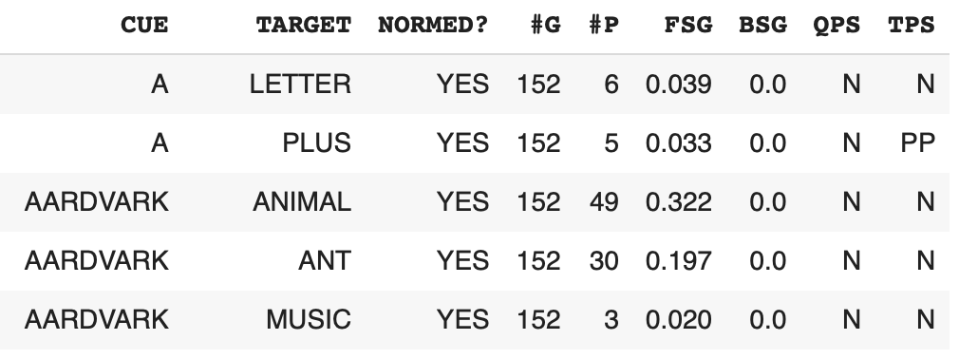
Dataset

Slide 7
Dataset Insights
In this Project “Cues to Use”, the dataset used for this study contains word associations as well as other properties of the cues and target words.
Properties about the associations such as the number of people responding to the cue, normed, forward and backward strength of the cue, and target words provide us with good insights into the relations between the words.
The dataset has been filtered with no backward strength, normed records, parts of speech being only nouns, verbs and adjectives and a minimum of 3 people responding to the cue.
Furthermore, we are also using the part of speech tags of the cue and target words to deep dive into their association.

Slide 8
Methods
We employ multiple methods to understand the associations of what words are reminded given certain cue words as shown below:
Part-of-Speech Tag
Vowels Association
Subtopics Association
Topics Association
In all the above methods, we remove records with incomplete data and use the Forward Strength value as the edge weights.

Slide 9
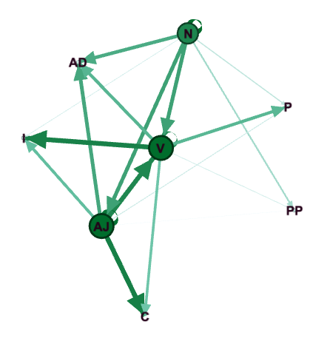
Parts-of-Speech Tag
In the dataset, the cue and target words are tagged with the respective Parts of Speech. Using these tags, we build a cue-target network and visualize them in Gephi software.
Characteristics -
Nodes: 8; Edges: 20
Avg Degree: 2.5
Avg Weighted Degree: 0.124
Methods -
Node Degree, Weighted Edges(FSG), Directed Graph

Slide 10
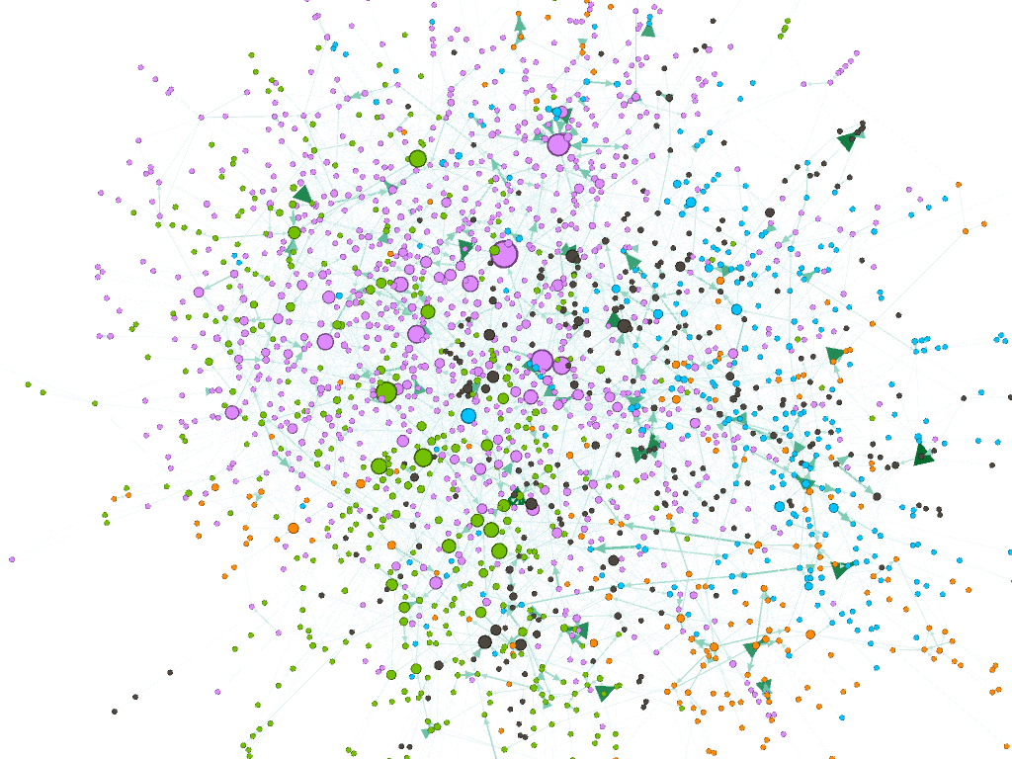
Vowels Association
The cue words are exclusively assigned vowels as the initial letter in this strategy. This is done because the dataset is too vast and specific word associations are desired. In addition, we are attempting to build a network in order to gain greater insights from it.
Characteristics -
Nodes: 2126; Edges: 4208
Avg Degree: 1.979
Avg Weighted Degree: 0.122
Avg Clustering Coeff: 0.014
Avg Path Length: 4.031
Communities: 8 (Res=5.0)
Methods -
Weighted Edges(FSG), Directed Graph, Communities, Betweenness centrality

Slide 11
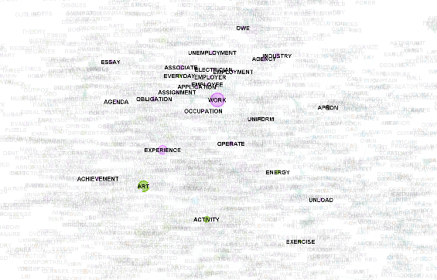
Vowels Association - Work
Taking the word Work, it can be observed that even though the Cue words starts with vowels, the word Work is still one the betweenness center.

Slide 12
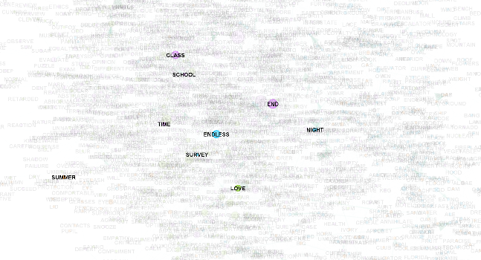
Vowels Association - Endless
Taking the word Endless which is also a betweenness center, the number of neighbors it has is quite less.

Slide 13
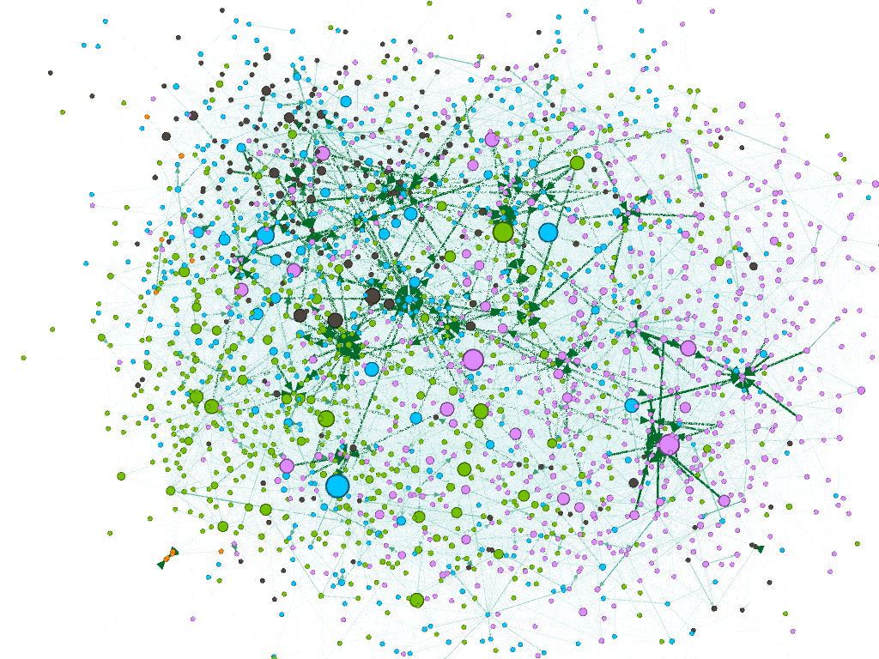
Sub-topic Association
Since the number of cue-target words is quite high, we get the hypernyms of these words and use them in place of the cue-target words. These words being used are the subtopics that can be used to generalize the words.
Characteristics -
Nodes: 2154; Edges: 17933
Avg Degree: 8.325
Avg Weighted Degree: 0.651
Avg Clustering Coeff: 0.082
Avg Path Length: 3.505
Communities: 12 (Res=2.0)
Methods -
Weighted Edges(FSG), Directed Graph, Communities, Betweenness centrality

Slide 14
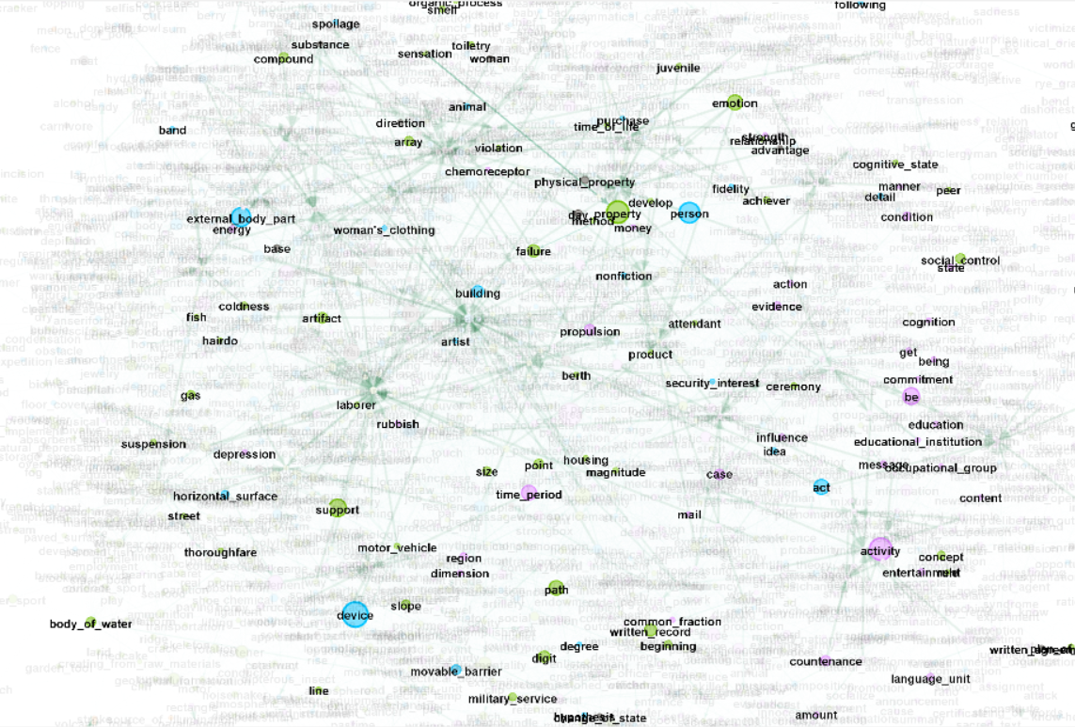
Sub-topic - Property
Taking the subtopic Property as an example, there is weak association between all of its neighbors.
It can also be noted that as it is one of the betweenness centers, the number of neighbors is quite high.

Slide 15
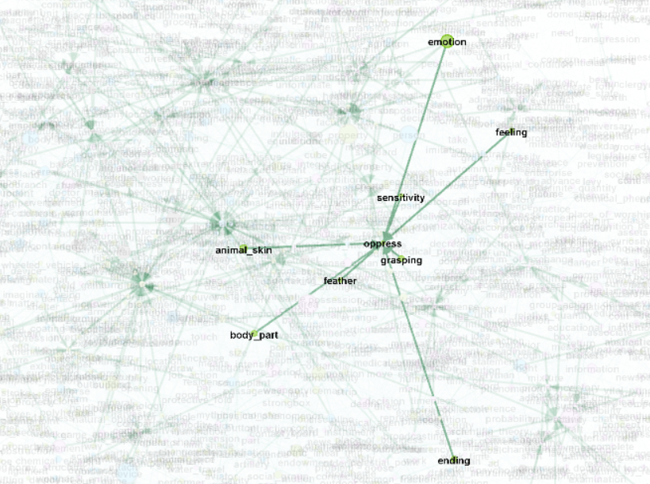
Sub-topic - Oppress
Taking the subtopic Oppress as an example, there is strong association between all of its neighbors.
As it is one of the node with strong associations, the number of neighbors is quite low.

Slide 16
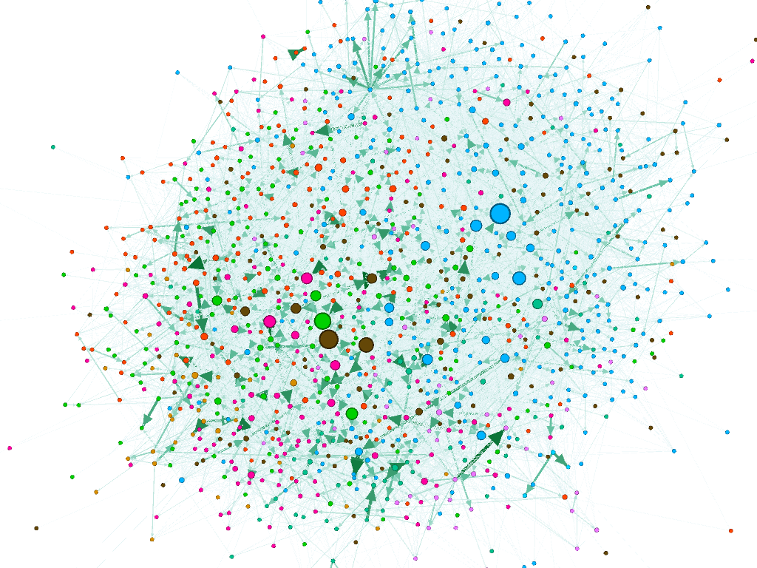
Topic Association
Since the number of cue-target words is quite high, we get the hypernyms of these words and use them in place of the cue-target words. To further generalize them, we take the hypernyms of these words which are the topics of the given words.
Characteristics -
Nodes: 1185; Edges: 14951
Avg Degree: 12.617
Avg Weighted Degree: 0.795
Avg Clustering Coeff: 0.155
Avg Path Length: 2.76
Communities: 10 (Res=1.25)
Methods -
Node Degree, Weighted Edges(FSG), Directed Graph, Communities

Slide 17
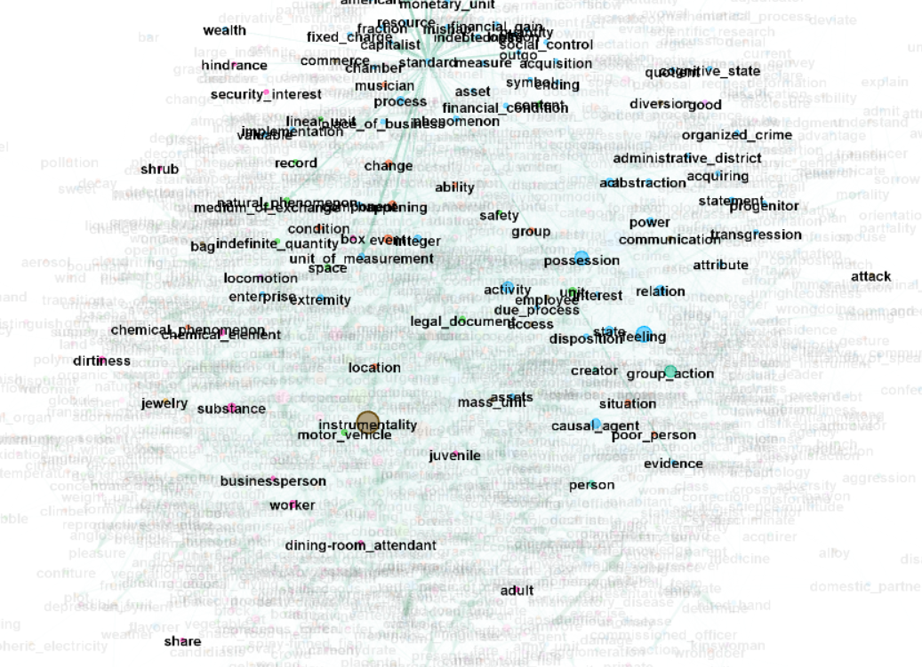
Topic - Standard
Taking the topic Standard as an example, it has mix of neighbors with strong and weak associations.
The number of neighbors also is quite high.

Slide 18
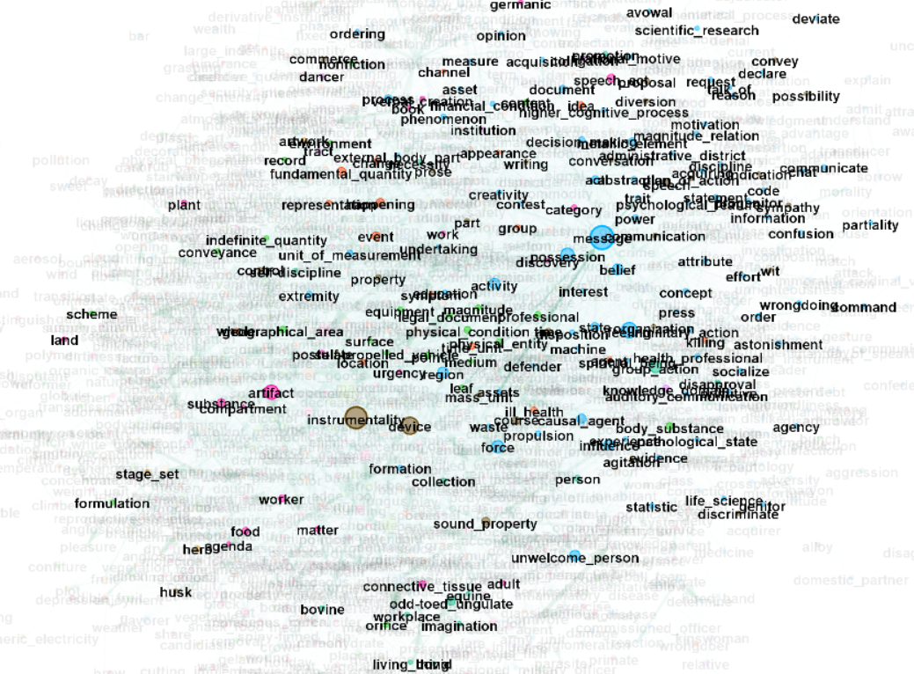
Topic - Message
As the topic Message is one of the betweenness center, the connection between its neighbors spans across different communities along with high number of neighbors.

Slide 19
Discussion & Conclusion
From the Part-of-Speech tagging, we understand that there is a strong relationship between Nouns, Verbs and Adjectives but could be biased as there is not enough data about other parts of speech.
The vowels association network follows a heterogeneous network.
In the Subtopics association, it can be seen that there are some subtopics which have highest association with others and these are not as well connected as others.
In the Topics association, the network simulates a real-world network where it acts like a scale-free graph (small world).

Slide 20
Limitations
One of the primary limitations was visualizing and analyzing high number of nodes and edges in a tool like Gephi which made computation a challenge.
Another limitation was the data acquisition of highly relevant data sources to map its features to the current dataset.
Future Scope
The study can entail an application of Machine learning models to predict the target words on the CUE words.
Including sub-features like sound of the word, topic modelling and applications of concepts like community detection, etc on a larger dataset with more features can make this study interesting.

Slide 21
Citations and References
Adaptive Factorization Network: Learning Adaptive-Order Feature Interactions Weiyu Cheng, Yanyan Shen,∗Linpeng Huang, Shanghai Jiao Tong University{weiyu cheng, shenyy, lphuang}@sjtu.edu.cn
Nelson, McEvoy & Schreiber: http://w3.usf.edu/FreeAssociation/AppendixA/index.html
https://unsplash.com/photos/C5SUkYZT7nU
https://pixabay.com/photos/abc-alphabet-alphabet-letter-blank-3523454/

Slide 22
Thank You

